Slide 1
SIT210 – Embedded Device Development (Project Pitch)
Moving robot for monitoring the movements of pets or kids.
Name: Mehul Warade
Student Id.: 217238626

Slide 2
Can’t find your pet! Don’t worry, check your email.
Pets can be very versatile at times.
There are some components in market like the gps tracker, Whistle Pet Tracker, etc.
But these components cannot work over long range as they are mainly made up of Bluetooth trackers.
Hence there arises the need for something that a person can use anywhere at there ease of time.
Notes:
1. People don’t always have time to roam behind them checking where they go and what they do.

Slide 3
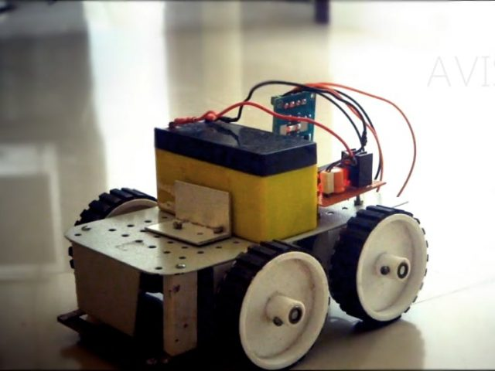
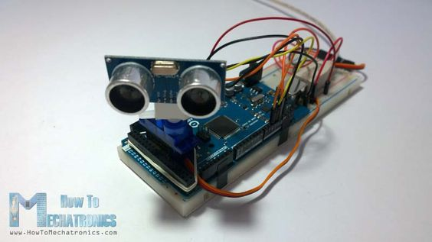
Monitoring the movements of pet using an embedded system!
A smart robot who follows the pet and send the location of the pet in real time using IFTTT services.

Slide 4
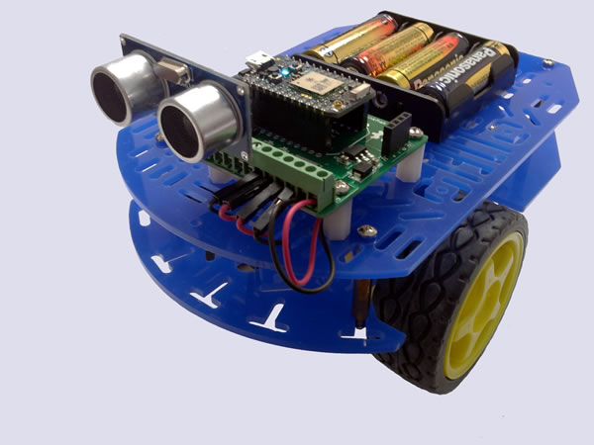
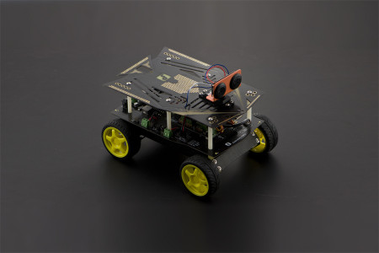
Breakdown of the robot components and its working:
The robot will be made using a photon and two ultrasonic sensors.
Two sensors are used so that the pet doesn’t go into the blind-spot of the robot.
The data from the sensors will be processed by the photon and then it will power the motor
so that the robot follows the pet.
Once the motion stops, the photon will make use of IFTTT services to send an email/ notification
telling the exact location where it is.

Slide 5
Thank You.

